Slide 1
Topics to be Covered:
Exception Handling in Java
Hierarchy of Exception classes
Types of Java Exceptions
Java Exception Keywords
try
catch
finally
throw
throws
Java try-catch : Examples
Multiple Catch Blocks
Order of Catch Blocks
Nested try-catch block
finally block
throw keyword
throws keyword
User-defined Exceptions

Slide 2
Exception Handling in Java

Slide 3
Exception Handling in Java
The Exception Handling in Java is one of the powerful mechanism to handle the runtime errors so that the normal flow of the application can be maintained.
In Java, an exception is an event that disrupts the normal flow of the program. It is an object which is thrown at runtime.
Advantage of Exception Handling
The core advantage of exception handling is to maintain the normal flow of the application. An exception normally disrupts the normal flow of the application; that is why we need to handle exceptions. Let's consider a scenario:
statement 1;
statement 2;
statement 3;
statement 4;
statement 5;//exception occurs
statement 6;
statement 7;
statement 8;
statement 9;
statement 10;
Suppose there are 10 statements in a Java program and an exception occurs at statement 5; the rest of the code will not be executed, i.e., statements 6 to 10 will not be executed.
However, when we perform exception handling, the rest of the statements will be executed. That is why we use exception handling in Java.

Slide 4
Hierarchy of Exception Classes

Slide 5
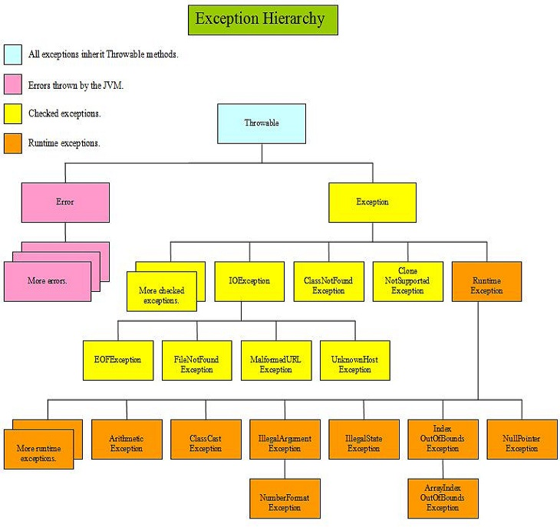
Hierarchy of Exception Classes

Slide 6
Types of Java Exceptions

Slide 7
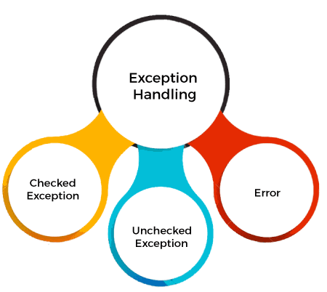
Types of Java Exceptions
There are mainly two types of exceptions: checked and unchecked. An error is considered as an unchecked exception.
However, according to Oracle, there are three types of exceptions namely:
Checked Exception
Unchecked Exception
Error

Slide 8
Types of Java Exceptions
1) Checked Exception
The classes that directly inherit the Throwable class except RuntimeException and Error are known as checked exceptions. For example, IOException, SQLException, etc.
Checked exceptions are checked at compile-time.
2) Unchecked Exception
The classes that inherit the RuntimeException are known as unchecked exceptions. For example, ArithmeticException, NullPointerException, ArrayIndexOutOfBoundsException, etc.
Unchecked exceptions are not checked at compile-time, but they are checked at runtime.
3) Error
Error is irrecoverable. Some example of errors are OutOfMemoryError, VirtualMachineError, AssertionError etc.

Slide 9
Java Exception Keywords

Slide 10
Java Exception Keywords
Keywords | Description
try | The "try" keyword is used to specify a block where we should place an exception code. It means we can't use try block alone. The try block must be followed by either catch or finally.
catch | The "catch" block is used to handle the exception. It must be preceded by try block which means we can't use catch block alone. It can be followed by finally block later.
finally | The "finally" block is used to execute the necessary code of the program. It is executed whether an exception is handled or not.
throw | The "throw" keyword is used to throw an exception.
throws | The "throws" keyword is used to declare exceptions. It specifies that there may occur an exception in the method. It doesn't throw an exception. It is always used with method signature.

Slide 11
Java try-catch

Slide 12
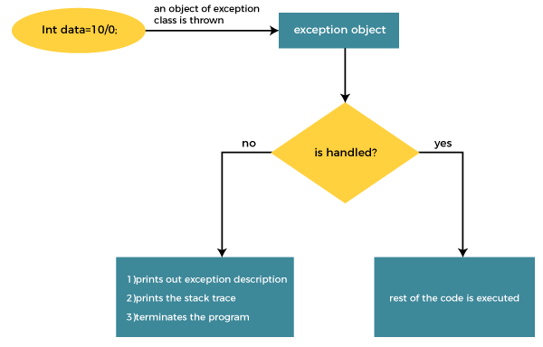
Internal Working of Java try-catch block

Slide 13
Java try-catch block
Java try block is used to enclose the code that might throw an exception. It must be used within the method.
If an exception occurs at the particular statement in the try block, the rest of the block code will not execute. So, it is recommended not to keep the code in try block that will not throw an exception.
Java try block must be followed by either catch or finally block.
Syntax of Java try-catch
Syntax of try-finally block
try
{
//code that may throw an exception
}
catch(Exception_class_Name ref)
{
// code for handling exception
}
try
{
//code that may throw an exception
}
finally
{
// necessary code for execution
}

Slide 14
Example 1 (Without Exception Handling)
Problem without exception handling:
Let's try to understand the problem if we don't use a try-catch block.
public class TryCatchEx1
{
public static void main(String[] args)
{
int data=50/0; //may throw exception
System.out.println("rest of the code");
}
}
Output:
Exception in thread "main" java.lang.ArithmeticException: / by zero
In the above example, the rest of the code is not executed (in such case, the rest of the code statement is not printed).
There might be 100 lines of code after the exception. If the exception is not handled, all the code below the exception won't be executed.

Slide 15
Example 2 (With Exception Handling)
Problem with exception handling:
Let's see the solution of the above problem by a java try-catch block.
public class TryCatchEx2
{
public static void main(String[] args)
{
try
{
int data=50/0; //may throw exception
}
//handling the exception
catch(ArithmeticException e)
{
System.out.println(e);
}
System.out.println("rest of the code");
}
}
Output:
java.lang.ArithmeticException: / by zero
rest of the code
As displayed in the above example, the remaining code is executed, i.e., the rest of the code statement is printed.

Slide 16
Example 3 (With Exception Handling)
public class TryCatchEx3
{
public static void main(String[] args)
{
try
{
int data=50/0; //may throw exception
// if exception occurs, the remaining statements will not execute
System.out.println("rest of the block code");
}
// handling the exception
catch(ArithmeticException e)
{
System.out.println(e);
}
}
}
Output:
java.lang.ArithmeticException: / by zero
Here, we can see that if an exception occurs in the try block, the rest of the block code will not execute.

Slide 17
Example 4 (With Exception Handling)
public class TryCatchEx4
{
public static void main(String[] args)
{
try
{
int arr[]= {1,3,5,7};
System.out.println(arr[10]); //may throw exception
}
// handling the array exception
catch(ArrayIndexOutOfBoundsException e)
{
System.out.println(e);
}
System.out.println("rest of the code");
}
}
Output:
java.lang.ArrayIndexOutOfBoundsException: 10
rest of the code
Here, we are trying to access element at index 10 whereas the size of the array is 4.
Hence, ArrayIndexOutOfBoundsException occurs.

Slide 18
Multiple catch blocks

Slide 19
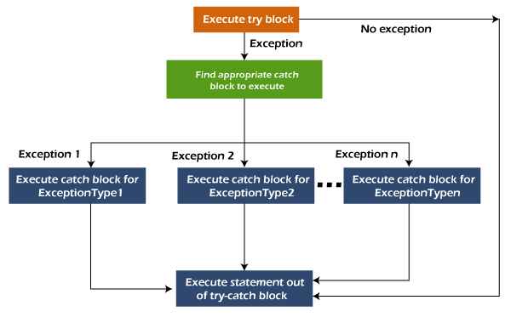
Multiple catch blocks
Java Multi-catch block
A try block can be followed by one or more catch blocks. Each catch block must contain a different exception handler.
So, if you have to perform different tasks at the occurrence of different exceptions, use java multi-catch block.
Note:
At a time only one exception occurs and at a time only one catch block is executed.
All catch blocks must be ordered from most specific to most general, i.e. catch for ArithmeticException must come before catch for Exception.
Flowchart of Multi-catch Block

Slide 20
Example 1 (Multiple Catch Blocks)
public class MultipleCatch1
{
public static void main(String[] args)
{
try
{
int a[]=new int[5];
a[5]=30/0; //raises an exception
}
catch(ArithmeticException e)
{
System.out.println("Arithmetic Exception occurs");
}
catch(ArrayIndexOutOfBoundsException e)
{
System.out.println("ArrayIndexOutOfBounds Exception occurs");
}
catch(Exception e)
{
System.out.println("Parent Exception occurs");
}
System.out.println("rest of the code");
}
}
Output:
Arithmetic Exception occurs
rest of the code

Slide 21
Example 2 (Multiple Catch Blocks)
public class MultipleCatch2
{
public static void main(String[] args)
{
try
{
int a[]=new int[5];
System.out.println(a[10]); //raises exception
}
catch(ArithmeticException e)
{
System.out.println("Arithmetic Exception occurs");
}
catch(ArrayIndexOutOfBoundsException e)
{
System.out.println("ArrayIndexOutOfBounds Exception occurs");
}
catch(Exception e)
{
System.out.println("Parent Exception occurs");
}
System.out.println("rest of the code");
}
}
Output:
ArrayIndexOutOfBounds Exception occurs
rest of the code

Slide 22
Example 3 (Multiple Catch Blocks)
public class MultipleCatch3
{
public static void main(String[] args)
{
try
{
String s=null;
System.out.println(s.length()); // raises exception
}
catch(ArithmeticException e)
{
System.out.println("Arithmetic Exception occurs");
}
catch(ArrayIndexOutOfBoundsException e)
{
System.out.println("ArrayIndexOutOfBounds Exception occurs");
}
catch(Exception e)
{
System.out.println("Parent Exception occurs");
}
System.out.println("rest of the code");
}
}
Output:
Parent Exception occurs
rest of the code
Note:
As the exception raised out of try block do not match ArithmeticException and ArrayIndexOutOfBoundsException, hence Exception class matches.

Slide 23
Order of catch blocks

Slide 24
Example 4 (Order of catch blocks)
public class MultipleCatch4
{
public static void main(String[] args)
{
try
{
String s=null;
System.out.println(s.length()); // raises exception
}
catch(Exception e)
{
System.out.println("Parent Exception occurs");
}
catch(ArithmeticException e)
{
System.out.println("Arithmetic Exception occurs");
}
catch(ArrayIndexOutOfBoundsException e)
{
System.out.println("ArrayIndexOutOfBounds Exception occurs");
}
System.out.println("rest of the code");
}
}
Output:
Compile time Error
Note:
Always catch blocks must be from most specific to most general order.
As Exception is super class of ArrayIndexOutOfBoundsException and ArithmeticException class, hence the order of catch blocks is not correct.

Slide 25
Nesting of try blocks

Slide 26
Nesting of try block
Sometimes a situation may arise where a part of a block may cause one error and the entire block itself may cause another error. In such cases, exception handlers have to be nested.
For example, the inner try block can be used to handle ArrayIndexOutOfBoundsException while the outer try block can handle the ArithemeticException (division by zero).
try //outer try block
{
statement 1;
//try catch block within another try block
try //inner try block
{
statement 2;
}
catch(Exception e2) // inner catch block
{
// exception message
}
}
catch(Exception e1) // outer catch block
{
// exception message
}
If an exception is found in statement 1, then control will be shifted to the outer catch block.
If an exception is found in statement 2, then control will be shifted to the inner catch block. In case the inner catch block is unable to handle it, then control will be shifted to the outer catch block.

Slide 27
Example (Nested try-catch block)
public class NestedTryBlock
{
public static void main(String args[])
{
//outer try block
try
{
//inner try block 1
try
{
System.out.println("divide by 0");
int b =39/0;
}
//inner catch block 1
catch(ArithmeticException e)
{
System.out.println(e);
}
//inner try block 2
try
{
int a[]=new int[5];
a[5]=4;
}
//inner catch block 2
catch(ArrayIndexOutOfBoundsException e)
{
System.out.println(e);
}
System.out.println("other statement");
} // End of outer try block
//catch block of outer try block
catch(Exception e)
{
System.out.println(" Outer catch handled");
}
System.out.println("normal flow..");
}
}

Slide 28
Example (Nested try-catch block)
Output:
divide by 0
java.lang.ArithmeticException: / by zero
java.lang.ArrayIndexOutOfBoundsException: Index 5 out of bounds for length 5
other statement
normal flow..

Slide 29
finally block

Slide 30
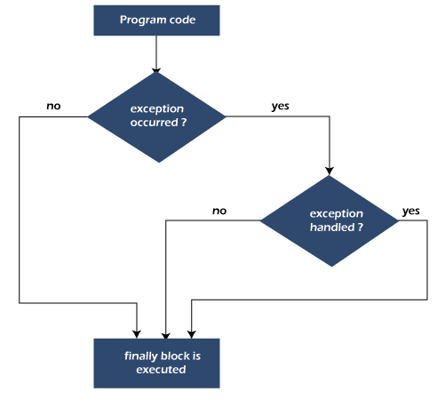
Java finally block
Java finally block is a block used to execute important code such as closing the connection, etc.
Java finally block is always executed whether an exception is handled or not. Therefore, it contains all the necessary statements that need to be printed regardless of the exception occurs or not.
The finally block follows the try-catch block.

Slide 31
finally block : Example 01
CASE 01: When an exception does not occur
In the following example, Java program does not throw any exception, and the finally block is executed after the try block.
class TestFinallyBlock1
{
public static void main(String args[])
{
try
{
//below code do not throw exception
int data=25/5;
System.out.println(data);
}
//catch won't be executed
catch(NullPointerException e)
{
System.out.println(e);
}
//executed whether exception occurred or not
finally
{
System.out.println("finally block is executed");
}
System.out.println("rest of the code");
}
}
Output:
5
finally block is executed
rest of the code

Slide 32
finally block : Example 02
CASE 02: When an exception occurs but is not handled by the catch block
Here, the code throws an exception however the catch block cannot handle it. Despite this, the finally block is executed after the try block and then the program terminates abnormally.
class TestFinallyBlock2
{
public static void main(String args[])
{
try
{
System.out.println("Inside try block");
//below code throws an exception
int data=25/0;
System.out.println(data);
}
//catch won't be executed
catch(NullPointerException e)
{
System.out.println(e);
}
//executed regardless of exception occurred or not
finally
{
System.out.println("finally block is executed");
}
// This line will not execute
System.out.println("rest of the code");
}
}
Output:
Inside try block
finally block is executed
Exception in thread "main" java.lang.ArithmeticException: / by zero at TestFinallyBlock2.main(TestFinallyBlock2.java:9)

Slide 33
finally block : Example 03
CASE 3: When an exception occurs and is handled by the catch block
The following example where the Java code throws an exception and the catch block handles the exception. Later the finally block is executed after the try-catch block. Further, the rest of the code is also executed normally.
class TestFinallyBlock2
{
public static void main(String args[])
{
try
{
System.out.println("Inside try block");
//below code throws an exception
int data=25/0;
System.out.println(data);
}
//catch will be executed
catch(ArithmeticException e)
{
System.out.println(“Exception Handled”);
System.out.println(e);
}
//executed regardless of exception occurred or not
finally
{
System.out.println("finally block is executed");
}
// This line will execute
System.out.println("rest of the code");
}
}
Output:
Inside try block
Exception Handled
java.lang.ArithmeticException: / by zero
finally block is executed
rest of the code

Slide 34
throw keyword

Slide 35
Java throw keyword
The Java throw keyword is used to throw an exception explicitly.
We specify the exception object which is to be thrown. The Exception has some message with it that provides the error description.
We can throw either checked or unchecked exceptions in Java by throw keyword. It is mainly used to throw a custom exception.
We can also define our own set of conditions and throw an exception explicitly using throw keyword. For example, we can throw ArithmeticException if we divide a number by another number.
The syntax of the Java throw keyword is given below.
throw Instance ;
Where the Instance must be of type Throwable or subclass of Throwable. For example, Exception is the sub class of Throwable and the user-defined exceptions usually extend the Exception class.
For Example:
throw new exception_class("error message");
throw new IOException("sorry device error");

Slide 36
Throwing exception : Example
In this example, we have created a method named validate() that accepts an integer as a parameter.
If the age is less than 18, we are throwing the ArithmeticException otherwise print a message welcome to vote.
public class TestThrow1
{
//method to check if person is eligible to vote or not
public static void validate(int age)
{
if(age<18)
{
//throw Arithmetic exception if not eligible to vote
throw new ArithmeticException("Person is not eligible to vote");
}
else
{
System.out.println("Person is eligible to vote!!");
}
}
public static void main(String args[])
{
//calling the method
validate(13);
System.out.println("rest of the code");
}
}
Output:
Exception in thread "main" java.lang.ArithmeticException: Person is not eligible to vote
at TestThrow1.validate(TestThrow1.java:6)
at TestThrow1.main(TestThrow1.java:15)

Slide 37
throws keyword

Slide 38
Java throws keyword
The Java throws keyword is used to declare an exception.
It gives information to the programmer that there may occur an exception. So, it is better for the programmer to provide the exception handling code so that the normal flow of the program can be maintained.
Syntax of Java throws :
return_type method_name() throws exception_class_name
{
//method code
}
Note:
Only checked exceptions should be declared.
It provides information to the caller of the method about the exception.

Slide 39
Java throws keyword
public class TestThrows
{
//defining a method
public static int divideNum(int m, int n) throws ArithmeticException
{
int div = m / n;
return div;
}
public static void main(String[] args)
{
TestThrows obj = new TestThrows();
try
{
System.out.println(obj.divideNum(5, 0));
}
catch (ArithmeticException e)
{
System.out.println("\nNumber cannot be divided by 0");
}
System.out.println("Rest of the code");
}
}
Output:
Number cannot be divided by 0
Rest of the code

Slide 40
User-defined exception

Slide 41
User defined Exception
Java provides us the facility to create our own exceptions which are basically derived classes of Exception.
Creating our own Exception is known as a custom exception or user-defined exception.
Basically, Java custom exceptions are used to customize the exception according to user needs. In simple words, we can say that a User-Defined Exception or custom exception is creating your own exception class and throwing that exception using the ‘throw’ keyword.
Example:
class MyException extends Exception
{
}
//A Class that uses above MyException
public class setText
{
public static void main(String args[])
{
try
{
// Throw an object of user defined exception
throw new MyException();
}
catch (MyException ex)
{
System.out.println("Caught");
}
}
}
Output:
Caught

Slide 42
Thank You

